Slide 1
Teaching Disciplinary Literacy: Science, Math, Technical Subjects
Timothy Shanahan
University of Illinois at Chicago
www.shanahanonliteracy.com

Slide 2
State of the Art
Most of the work on these issues in the technical subjects has been done in science (e.g., physics, chemistry, botany)
There is a very small amount in mathematics
And, almost nothing in any of the other related subjects
That means my presentation will be unbalanced--there will be more attention to science than to math or vocational education, etc.
I’ll have to ask you to do the same thing that I do which is to the use the science information by analogy—think about how your subject differs in these regards and how you would address that similarly or differently

Slide 3
Pedagogical Idea of Disciplinary Literacy
Research needs to determine the special nature of text in a discipline and the specialized or unique ways that disciplinary experts read
Educators can then turn that knowledge into curriculum and instruction to introduce students to nascent forms of those text features or ways of reading/writing
Explicit instruction and explanation should enable more students to become nascent scientists, historians, engineers, etc.
Problem with mathematics? Is it an exception?

Slide 4
What do students need to learn?
Content of your subject
How that content is created
How _______ (scientists, mathematicians, engineers, etc.) think or approach problems
How they read and write

Slide 5
Scientific Practices
Asking questions and defining problems
Developing and using models
Planning and carrying out investigations
Analyzing and interpreting data
Using mathematics and computational thinking
Constructing explanations and designing solutions
Engaging in argument from evidence
Obtaining, evaluating and communicating information

Slide 6
1. Asking questions and defining problems
Formulating empirically answerable questions
Establishing what is already known
Determining which questions have to be satisfactorily answered

Slide 7
2. Developing and Using Models
Development of models and simulations to help develop explanations about natural phenomena
Models make it possible to go beyond observations
And identify flaws in the reasoning

Slide 8
3. Planning and Carrying Out Investigations
Identification of what is to be recorded
Identification of independent and dependent variables
Collecting and recording data

Slide 9
4. Analyzing and Interpreting Data
Putting data into form that allows it to be interpreted (tabulation, graphical interpretation, visual analysis, statistical analysis)
Identification of patterns in data

Slide 10
5. Using Mathematical and Computational Thinking
Math is used to represent physical variables, their relationships, and phenomena like growth or change or development
Mathematical approaches allow for predictions of future behavior of physical systems

Slide 11
6. Constructing Explanations and Designing Solutions
Construct logically coherent explanations of phenomena that incorporate explanations that are consistent with available evidence

Slide 12
7. Engaging in Argument from Evidence
Reasoning and argument are essential or identifying strengths and weaknesses of a line of reasoning for finding the best explanation
Scientists must defend their explanations through the use of evidence

Slide 13
8. Obtaining, Evaluating, and Communicating Information
Science cannot advance if scientists can’t communicate their findings clearly and persuasively
A major practice of science is communicating explanations orally and through writing (including graphical information)
Science requires the ability to derive meaning from scientific texts

Slide 14
The Role of Literacy in Science
Literacy is essential to recording methods and results of observations and experiments
These texts must be so explicit and complete that they render an investigation replicable
Researchers depend upon this written record for determining what is known and unknown
Scientists must be able to locate authoritative text and be able to access this make sense of that text

Slide 15
The Role of Literacy in Science (cont.)
Science texts are organized in particular ways (such as the structure of studies)
Science texts offer explanations of scientific phenomena… such explanations will often be accompanied by a description of the sources of the information

Slide 16
Differing Outlooks about Goal of Reading
Students | Scientists
With the goal of absorbing the information | With the goal of inquiry

Slide 17
Differing Approaches to Reading
How do students read? | How do scientists read?
From beginning to end | Skip around Use headings Read captions Compare text descriptions to visual representations Check their understanding

Slide 18
Disciplinary Literacy and Text Choice
Historians were not anti-textbook—they thought textbooks could play an important role in social studies instruction
However, across several studies, the historians are unified in the idea that history cannot be taught with single texts
The nature of history and the major research approaches used in history (i.e., collecting multiple accounts of events) require multiple texts

Slide 19
Disciplinary Literacy and Text Choice (cont.)
Scientists were skeptical of the idea of multiple texts
In science important to have a single accurate authoritative source
Not particularly interested in critical responses to school text
Their own reading procedures emphasize critical response when reading texts on high knowledge topics and less on other topics (Bazerman, 1985; Shanahan, et al., 2011)

Slide 20
Chemistry Note-taking
Substances | Properties | Processes | Interactions | Atomic Expression

Slide 21
How to Read Math
Read every word, one word at a time (every word counts)
Don’t depend on filling in the gaps with what you read later—you need to understand each line
No speed reading
Make sure you know the definitions of the terms and the meanings of the symbols
Might need to reread several times
Read with a pencil and paper (try to work the problems yourself—not just copying it out)

Slide 22
Content Area Vocabulary
Students need to learn terminology in all fields
The same study techniques would accomplish this no matter what the words
Graphic organizers, semantic maps, word sorts, rate knowledge of words, analyze semantic features of words, categorizing /mapping words, synonym webs, etc.

Slide 23
Disciplinary Literacy Vocabulary
Focus is on specialized nature of vocabulary of the subjects
Science: Greek and Latin roots (precise, dense, relatable, stable meanings that are recoverable)
History: metaphorical terms, terms with a political point of view
Notes:
Haploid: cell with a single set of unpaired chromosomes (half the normal number, not from both parents)
Diploid: cell with two complete sets of chromosomes, one from each parent
Meiosis: cell division in which the new cells are not identical to the parent cells osis (less process or action)
Mitosis: cell division in which the new cells are identical to the parent cells (thread process)
Allopatric: non overlapping distribution of species (allo other / patric father/patrilinial)
Sympatric: overlapping distribution of species (sym together or the same

Slide 24
Disciplinary Literacy Vocabulary
Learning the nature of disciplinary literacy (science constructs words for precision, maximum interpretability/recoverability, relationships, and stability)
How to interpret morphology
How to use of context
Use of appropriate reference guides
Notes:
Haploid: cell with a single set of unpaired chromosomes (half the normal number, not from both parents)
Diploid: cell with two complete sets of chromosomes, one from each parent
Meiosis: cell division in which the new cells are not identical to the parent cells osis (less process or action)
Mitosis: cell division in which the new cells are identical to the parent cells (thread process)
Allopatric: non overlapping distribution of species (allo other / patric father/patrilinial)
Sympatric: overlapping distribution of species (sym together or the same)

Slide 25
Morphology Differs by Discipline
Of course, different disciplines use different words
But the frequency or value of prefixes, suffixes, and (especially) combining forms differs by discipline
See: Word ID: Assessment Across the Content Areas by Linda Gutlohn
& Frances Besselieu

Slide 26
Prefixes
 | ELA | Math | Science | Social Studies
com- | X | X | X | X
con- | X | X | X | X
de- | X | X | X | X
dis- |  | X |  | X
ex- | X | X | X | X
in- | X | X | X | X
inter- |  | X
pre- | X
pro- | X | X |  | X
re- | X | X | X | X
sub- | X | X
trans- |  |  | X
un- |  | X
Notes:
Trans – through or beyond

Slide 27
Prefixes
 | ELA | Math | Science | Social Studies
-al | X | X | X | X
-ar |  | X | X
-ary | X |  |  | X
-ate | X | X | X | X
-ation | X | X | X | X
-ent |  | X | X | X
-ic | X | X | X | X
-ism |  |  | X | X
-ist |  |  |  | X
-ity | X | X | X | X

Slide 28
Derivational Suffixes
 | ELA | Math | Science | Social Studies
-ive | X | X | X | X
-ize | X |  | X | X
-ment | X | X | X | X
-al | X | X | X | X
-ar |  | X | X
-ary | X |  |  | X
-ate | X | X | X | X
-ation | X | X | X | X
-ent |  | X | X | X
-ic | X | X | X | X
-ism |  |  | X | X

Slide 29
Derivational Suffixes (cont.)
 | ELA | Math | Science | Social Studies
-ist |  |  |  | X
-ity | X | X | X | X
-ive | X | X | X | X
-ize | X |  | X | X
-ment | X | X | X | X
-or |  |  | X | X
-sion | X | X | X | X
-tion | X | X | X | X
-ture | X |  |  | X

Slide 30
Greek Combining Forms
 | ELA | Math | Science | Social Studies
ana | X
arch |  |  |  | X
auto |  |  |  | X
bio |  |  | X | X
chem |  |  | X
cracy, crat |  |  |  | X
dem, demo |  |  |  | X
eco |  |  |  | X
electro, elect |  |  | X
endo |  |  | X
geo |  |  | X | X
Notes:
Arch: initial, beginning, original
Auto:: self
Cracy: denoting a particular kind of government or influence
Demo: people, population

Slide 31
Greek Combining Forms (cont.)
 | ELA | Math | Science | Social Studies
gon |  | X
gram |  | X
graph | X |  |  | X
hedron |  | X
hydro |  |  | X
logy (ology) | X |  | X | X
meter, metr |  | X | X
micro |  |  | X
nym, onym | X
oid |  |  | X
para | X | X
photo |  |  | X

Slide 32
Greek Combining Forms (cont.)
 | ELA | Math | Science | Social Studies
poly |  | X
scope |  |  | X
sphere |  |  | X | X
sym- |  | X
syn- | X |  | X
therm, thermo |  |  | X
tri- |  | X

Slide 33
Morpheme Frequency
Gutlohn & Bessellieu (2014) examined frequency of morphemes in 4500 multisyllabic content area words to identify the morpheme frequency
Half the morphemes occurred across content areas, though the words they appeared in may be content specific
The following morphemes were only frequent in science text (or math): trans, chem, electro, elect, endo, hydro, micro, oid, photo, scope, therm, thermo
The following morphemes were only frequent in math text (or science): un-, gon, gram, inter, hedron, poly, sym, tri

Slide 34
Morpheme Frequency (cont.)
The following morphemes were frequent only in science and one other discipline: ar, ism, or, bio, geo, logy, metr, meter, sphere, syn
The following morphemes were frequent only in math and one other discipline: ar, dis, metr, meter, sym

Slide 35
Disciplinary Literacy emphasizes specialized nature of vocabulary
Focus is on specialized nature of vocabulary in each subject area
Science: Greek and Latin roots (precise, dense, stable meanings that
are recoverable)
Example: DNA (deoxyribonucleic acid) is a nucleic acid, a macromolecule that stores information.
Notes:
De- less or FROM
Oxy- sugar
Ribo- structurally related to ribose
Nucleus nucleic acid –substance basic to life
A sugar derived from ribose in the form of a deoxyribose (structure) that is basic to life DNA

Slide 36
Specialized Nature of Vocabulary
History: metaphorical terms, terms with a political point of view
Example: Revolutionary movements in Europe and Asia were described to the American public as examples of Soviet Expansionism…. (Zinn, A People’s History);
Example: Civil War, War between the states, War of Northern aggression.
Example: The Gilded Age

Slide 37
Specialized Nature of Vocabulary
Literature: Words that evoke emotion, the senses, human relationships.
Example: …where I would have lived through all that impassioned,
insane joy of the hunt, when as I climb the rock, my face contorted,
gasping, shouting voluptuously senseless words…(Nabokov, Father’s
Butterflies).

Slide 38
Math Vocabulary
Many mathematical terms have both a common meaning and a mathematical meaning (and these are different)
Angle, constant, degree, expression, factor, gross, meter, natural, operation, order, parallel, power, product, problem, rational, etc.

Slide 39
Teach students to use context
Most science textbooks are compendiums of definitions/explanations of science concepts and their relationships
Most lesson plans encourage teachers to preteach vocabulary so students don’t get as much practice in making sense of definitions

Slide 40
Teach students to use reference works
Dictionary instruction
But using the more specialized reference works from a field of study

Slide 41
Sugar example: General dictionary
a sweet crystalline substance obtained from various plants, especially sugar cane and sugar beet, consisting essentially of sucrose, and used as a sweetener in food and drink.

Slide 42
Sugar example: Science dictionary
(saccharide) Any of a group of water soluble carbohydrates of relatively low molecular weight and having a sweet taste. The simple sugars are called monosaccharides. More complex sugars comprise between two and ten monosaccharides linked together: disaccharides contain two trisaccharides three, and so on. The name is often used to refer specifically to sucrose (cane or beet sugar). The suffix -ose is used in biochemistry to form the names of sugars.

Slide 43
Sugar example: Science dictionary
(saccharide) Any of a group of water soluble carbohydrates of relatively low molecular weight and having a sweet taste. The simple sugars are called monosaccharides. More complex sugars comprise between two and ten monosaccharides linked together: disaccharides contain two trisaccharides three, and so on. The name is often used to refer specifically to sucrose (cane or beet sugar). The suffix -ose is used in biochemistry to form the names of sugars.

Slide 44
Battleship example (History): General Dictionary
Any class of warships that are the most heavily armored and are equipped with the most powerful armament.

Slide 45
Battleship example: History dictionary
U.S. battleship is usually distinguished from its foreign counterparts by its heavy gun armament, sturdy protection, and relatively slow speed. Three distinct subtypes: 27 mixed-battery ships built 1888-1908; 22 all-big-gun “dreadnoughts” (1910-1923); and 10 fast battleships (1937-1944). Stricken from the Navy’s lists in January 1995. As ship killers, the battleships saw little action, yet they ultimately justified their existence in important subsidiary missions, the most significant being gunfire support for troops ashore.

Slide 46
Text is central to disciplines
Functional linguists are showing how texts differ across disciplines
But secondary teachers are increasingly trying to teach content without text
And now, CCSS is requiring the teaching of complex texts
Scientific text tends to be multimodal, with the graphic elements as important as the prose
Often ignored instructionally

Slide 47
Graphic Elements in the Disciplines
Think of the differences between the graphics in a math book and science book
Math books embed the formulas and graphic elements—controlling how the text is read (precision)
Science books require reader to move back and forth between graphics and prose (conceptual-multiple versions)

Slide 48
Scientific Graphics
There are a large number of tables, charts, graphics, 3-dimensional representations, scientific drawings, flowcharts, photographs, etc. used in scientific communication (and many ways to categorize these)
No attempt to show all possible graphics, just some major ones
Focus is on teaching students to identify their purposes and to interpret them appropriately (in relation to the rest of the scientific information)

Slide 49
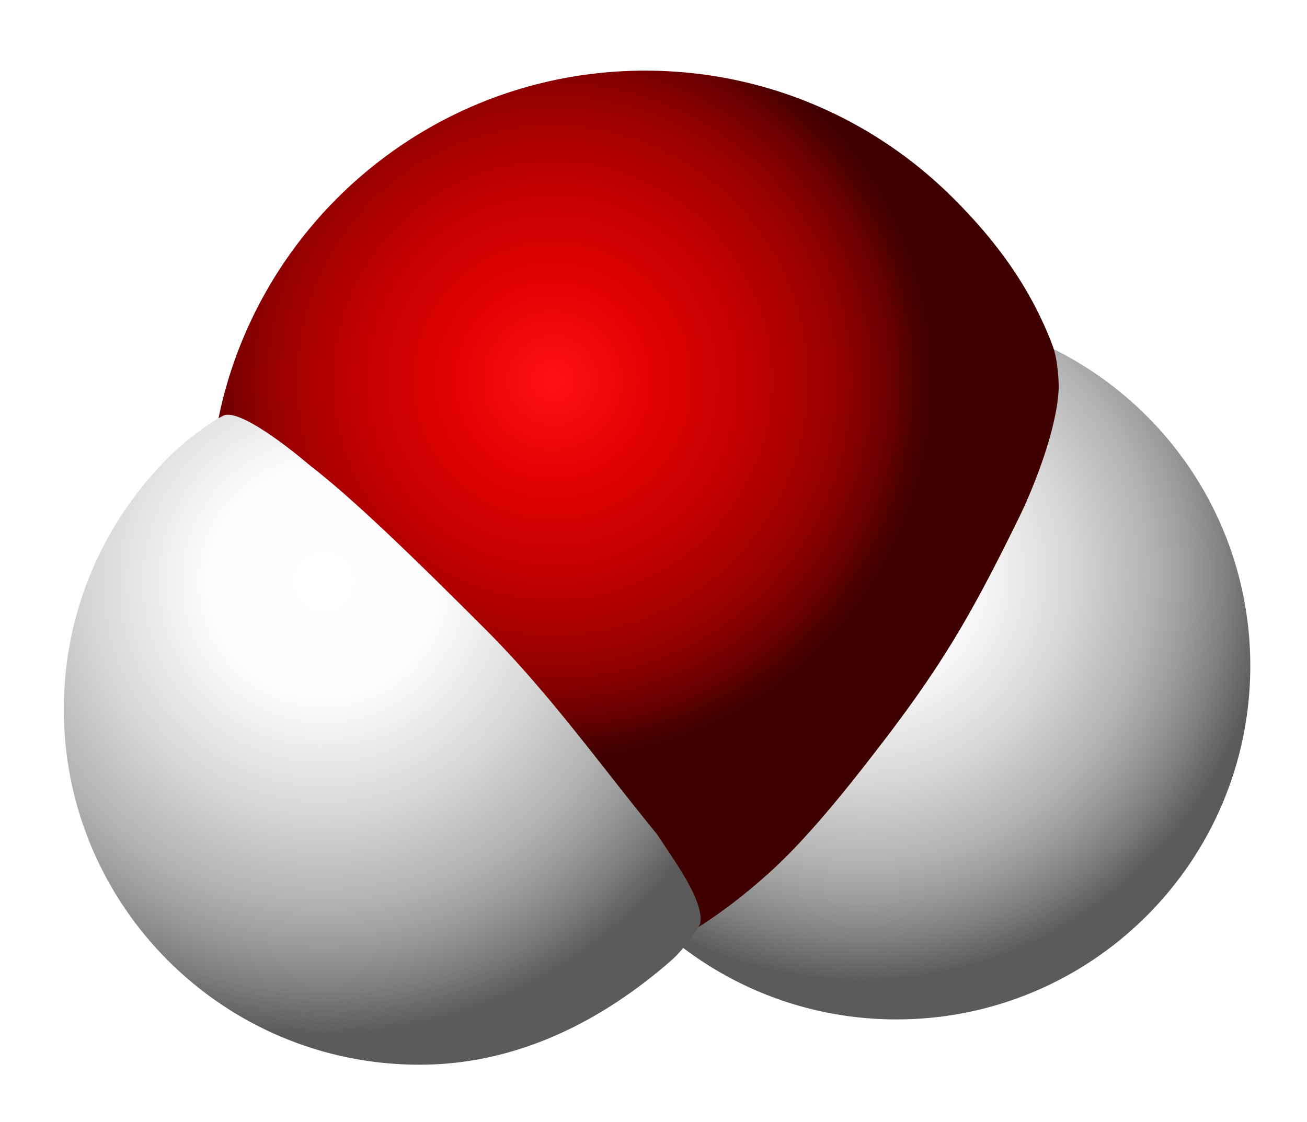
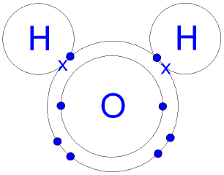
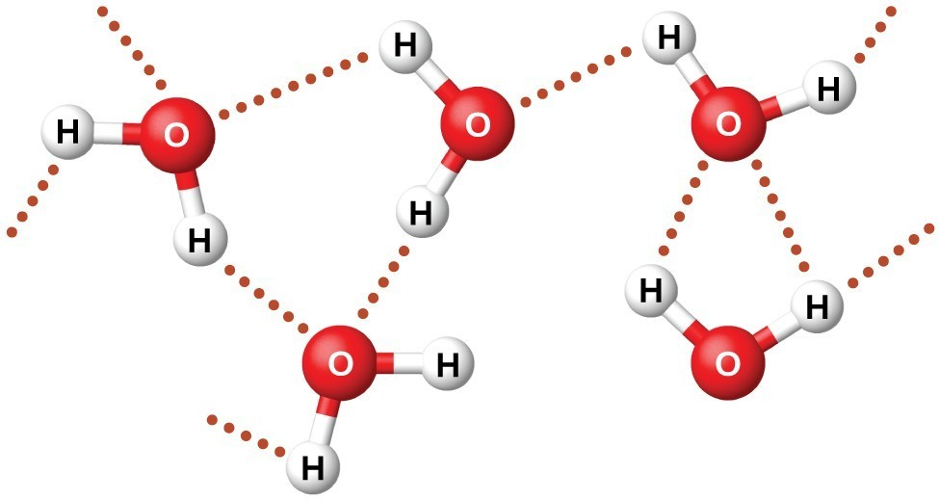
What do these have in common?
Notes:
Comparison of different graphics of water molecule– the purpose here is to show that these graphics, though they look quite different are actually the same thing (though they might be emphasizing different aspects of this molecule.

Slide 50
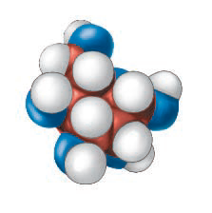
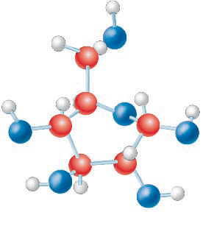
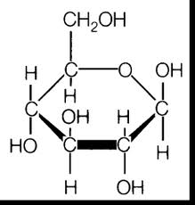
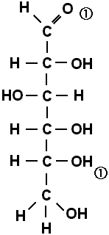
What do these have in common?
Notes:
Comparison of different graphics of sugar (glucose) molecule.

Slide 51
Graphic Purposes
Spatial graphics: represent spatial placement of objects or the physical relationships among objects or parts (e.g., photos, scientific drawings)
An understanding of spatial graphics is demonstrated by being able to describe (or remember) the relative placements of the items in the graphics
Not enough to remember the actual items represented—understanding their relationships is key

Slide 52
Graphic Purposes (cont.)
Sequential graphics: represent the steps in a process or cycle (e.g., flow charts)
An understanding of sequential graphics requires that readers be able to describe the steps in the process in an appropriate sequence (and key features of the process such as asymmetricity, circularity, etc.)

Slide 53
Graphic Purposes (cont.)
Comparative graphics: reveal similarities and differences in phenomena or processes (includes scientific drawings, tables, bar graphs, etc.)
Understanding comparative graphics requires that readers recognize what is being compared and to be able to draw appropriate generalizations from the comparisons

Slide 54
Graphic Purposes (cont.)
Classification/Hierarchical graphics: reveal taxonomic or rank relationships or arrangements among phenomena, objects, processes, etc. (includes tree diagrams, category graphs, etc.)
Understanding classification/hierarchical graphics requires recognizing what is being compared and whether the nature of the relations being pictured (e.g., superior to inferior, general to specific)

Slide 55
Graphic Purposes (cont.)
Causal graphics: reveal what conditions or actions lead to particular outcomes (can take many forms, but be especially careful of graphics that illustrate relationships between two variables-–those are not necessarily causal, but may be correlational)
Understanding requires being able to describe the antecedent the consequent and how the the former impacts the latter

Slide 56
Graphics Purposes
Spatial graphics
Sequential graphics
Comparative
Classification/Hierarchical
Causal

Slide 57
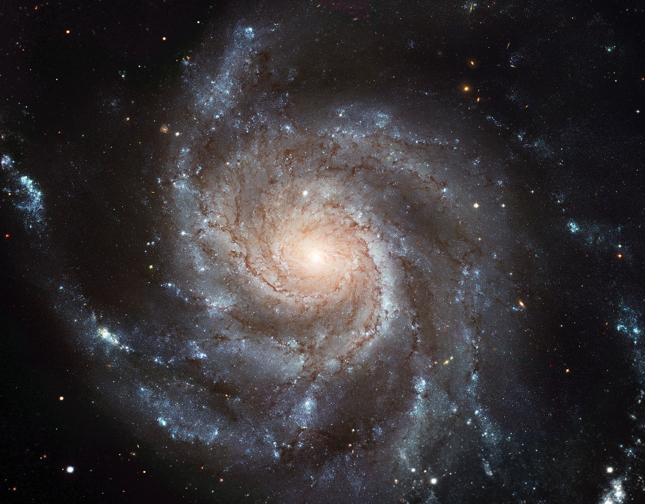
Spatial
Sequential
Comparative
Classif/Hierarch
Causal
Notes:
Most spiral galaxies consist of a flat, rotating disk containing stars, gas and dust, and a central concentration of stars known as the bulge. ... Together with irregular galaxies, spiral galaxies make up approximately 60% of galaxies in today'suniverse.
NOUN
SPATIAL

Slide 58
Spatial
Sequential
Comparative
Classif/Hierarch
Causal
Notes:
Process/verb: Water cycle
The water cycle describes how water evaporates from the surface of the earth, rises into the atmosphere, cools and condenses into rain or snow in clouds, and falls again to the surface as precipitation.
Transpiration: plants give off water through their pores
Infiltration: water seeping through the soil to the water table

Slide 59
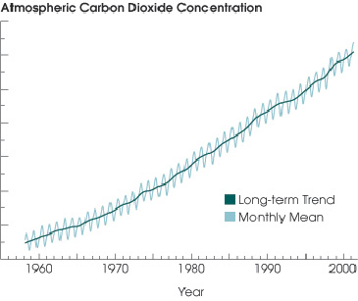
Spatial
Sequential
Comparative
Classif/Hierarch
Causal
Notes:
This is a comparison… it allows one to compare how much atmospheric carbon dioxide there was each decade since 1960

Slide 60
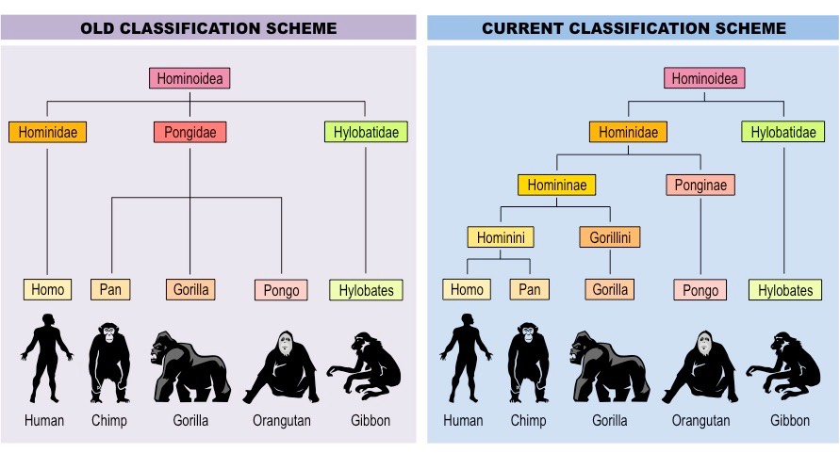
Spatial
Sequential
Comparative
Classif/Hierarch
Causal
Notes:
Classification and Comparison
Classification of hom-in-oid-ea;
We used to think man was a distinct or unique member of the hominoidea family… newer classification schemes recognize more fine grained distinctions and closer connections with some other members of the family.

Slide 61
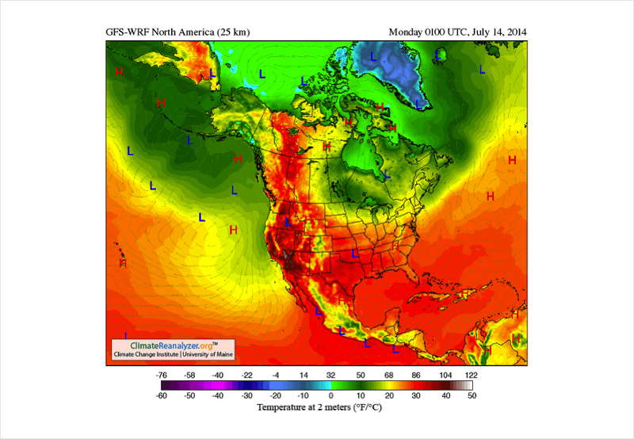
Spatial
Sequential
Comparative
Classif/Hierarch
Causal
Notes:
Spatial / Comaprative
Shows temperature locations

Slide 62
Spatial
Sequential
Comparative
Classif/Hierarch
Causal
Notes:
Classification (taxonomy) in hierarchical tree form (general to specific)

Slide 63
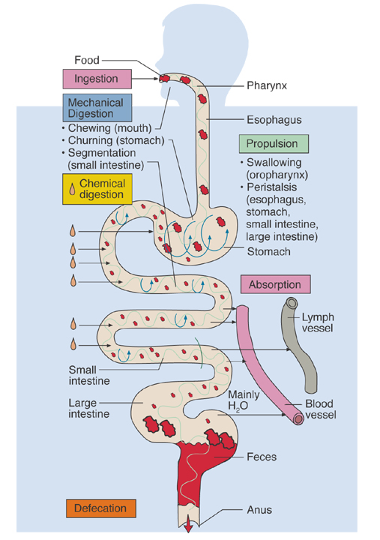
Spatial
Sequential
Comparative
Classif/Hierarch
Causal
Notes:
Sequential—illustrates the digestion process
Spatial—shows the placement of the digestion system

Slide 64
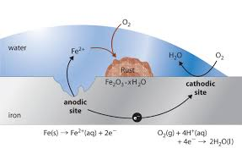
Spatial
Sequential
Comparative
Classif/Hierarch
Causal
Notes:
Shows iron rusting
Causal– shows how Oxygen merges into water and how the oxygen from water bonds with iron to create rust
Sequential—it is a process

Slide 65
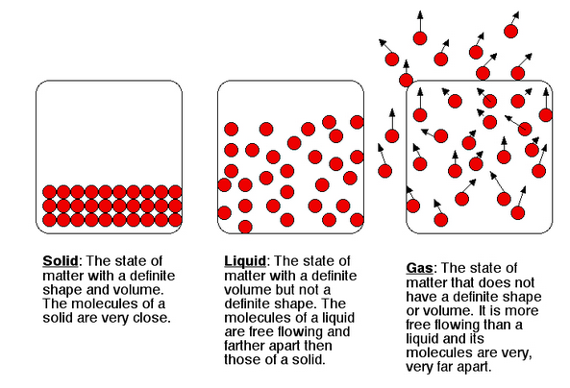
Spatial
Sequential
Comparative
Classif/Hierarch
Causal
Notes:
Comparison of different forms of H2O

Slide 66
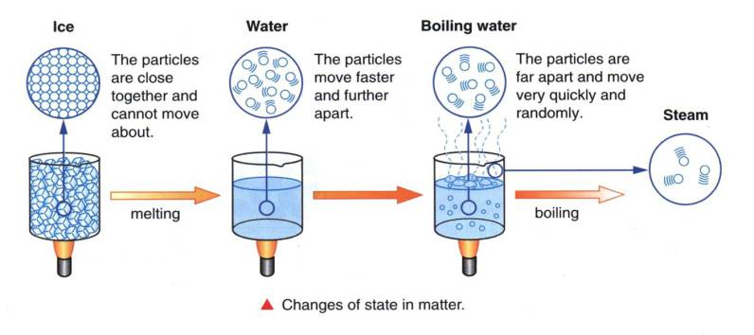
Spatial
Sequential
Comparative
Classif/Hierarch
Causal
Notes:
Causation—the areas show how the state of matter is changed by heat
Comparison

Slide 67
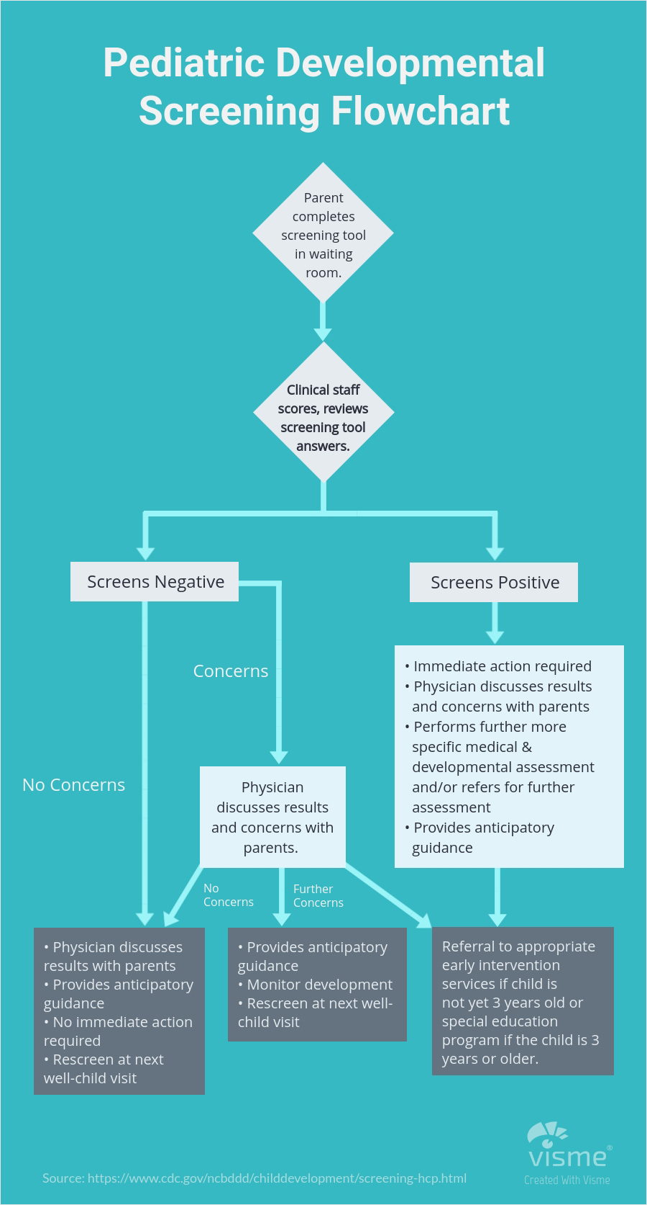
Spatial
Sequential
Comparative
Classif/Hierarch
Causal
Notes:
Sequence process flowchart

Slide 68
Spatial
Sequential
Comparative
Classif/Hierarch
Causal
Notes:
Causal relationships

Slide 69
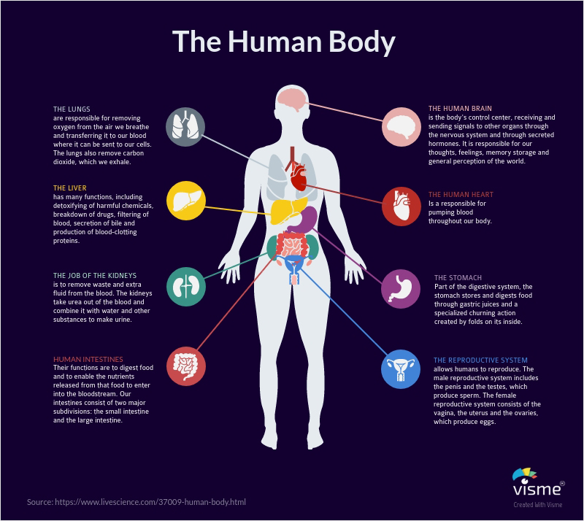
Spatial
Sequential
Comparative
Classif/Hierarch
Causal
Notes:
Spatial, classification

Slide 70
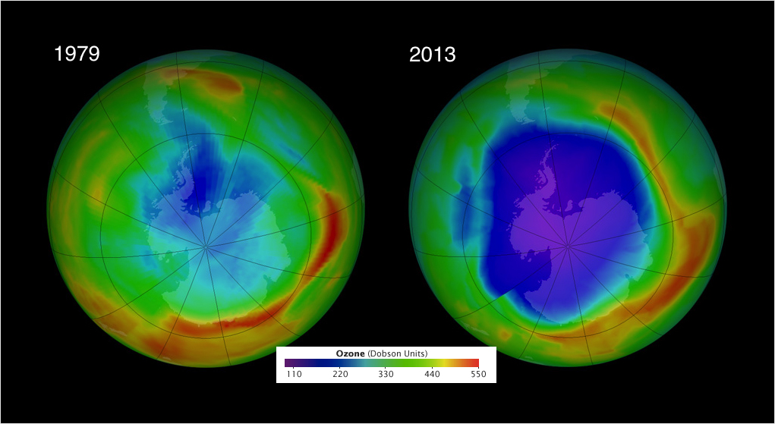
Spatial
Sequential
Comparative
Classif/Hierarch
Causal
Notes:
Comparison of ozone layer at two different times

Slide 71
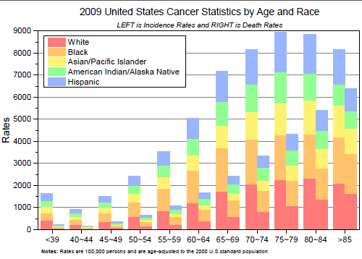
Spatial
Sequential
Comparative
Classif/Hierarch
Causal
Notes:
Comparison

Slide 72
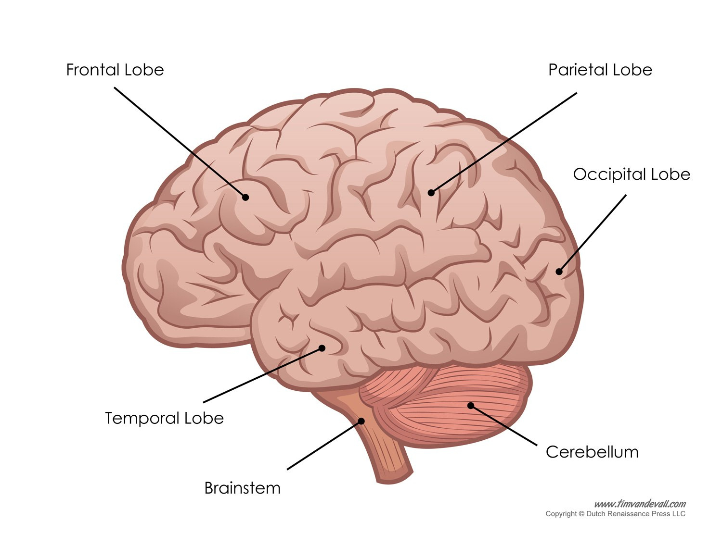
Spatial
Sequential
Comparative
Classif/Hierarch
Causal
Notes:
Spatial structure of human brain

Slide 73
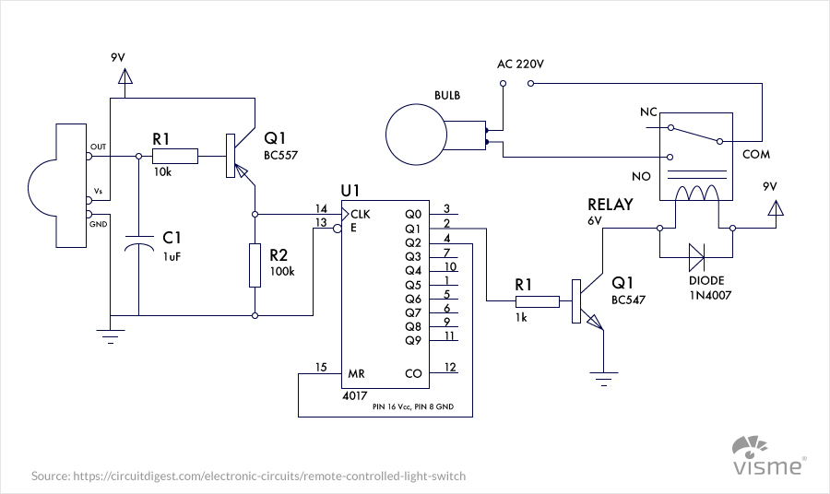
Spatial
Sequential
Comparative
Classif/Hierarch
Causal
Notes:
Spatial – engineering blueprint… showing circuits

Slide 74
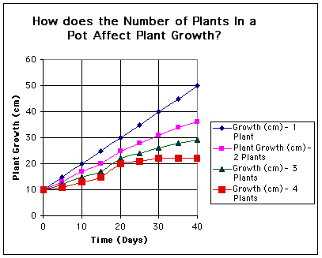
Spatial
Sequential
Comparative
Classif/Hierarch
Causal
Notes:
Causal—relationship of growth rates in an experiment (crowding impact on growth)
Comparison

Slide 75
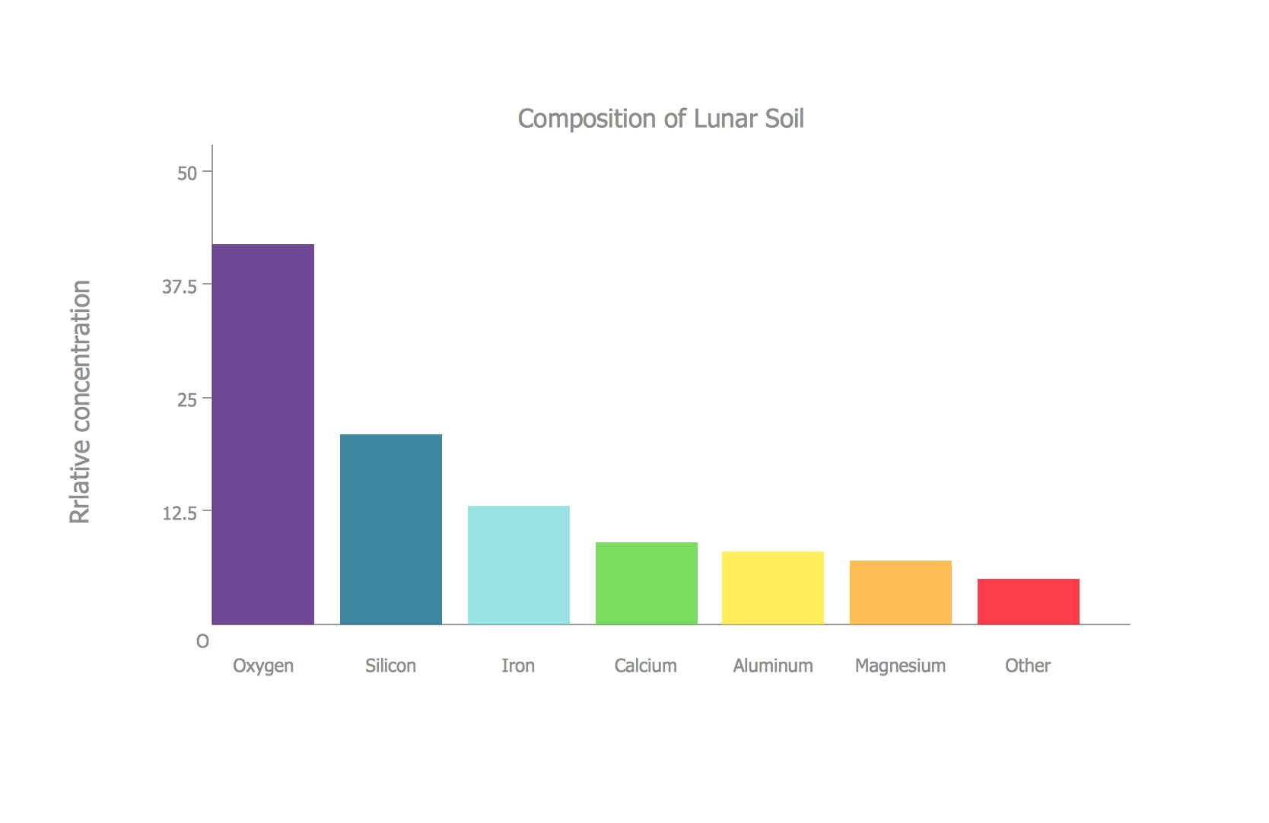
Spatial
Sequential
Comparative
Classif/Hierarch
Causal
Notes:
Comparison of lunar soil elements

Slide 76
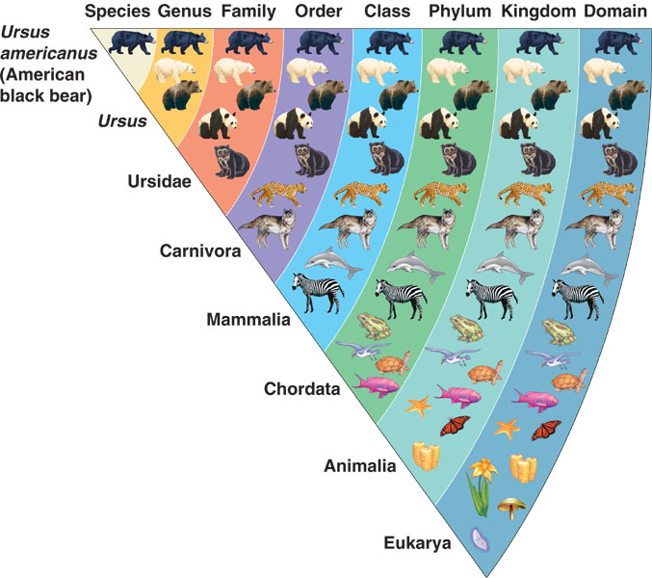
Spatial
Sequential
Comparative
Classif/Hierarch
Causal
Notes:
Classification – Classifying where the American black bear fits in biological classification system (taxonomy ranks)
Comparative

Slide 77
Standards are an outcome of this work
Common Core State Standards for English Language Arts
and Literacy in History/Social Studies & Science/Technical Subjects

Slide 78
Literacy in Science/Technical Subjects
Determine the meaning of symbols, key terms, and other domain-specific words and phrases as they are used in a specific scientific or technical texts and topics.
Integrate quantitative or technical information expressed in words in a text with a version of that information expressed visually (e.g., in a flowchart, diagram, model, graph, or table).
Distinguish among facts, reasoned judgment based on research findings, and speculation in a text.
Follow precisely a complex multistep procedure when carrying out experiments, taking measurements, or performing technical tasks, attending to special cases or exceptions defined in the text.
Analyze the structure of the relationships among concepts in a text, including relationships among key terms (e.g., force, friction, reaction force, energy).

Slide 79
Literacy in Science/Technical Subjects
Translate quantitative or technical information expressed in words in a text into visual form (e.g., a table or chart) and translate information expressed visually or mathematically (e.g., in an equation) into words.
Compare and contrast findings presented in a text to those from other sources (including their own experiments), noting when the findings support or contradict previous explanations or accounts.
Cite specific textual evidence to support analysis of science and technical texts, attending to important distinctions the author makes and to any gaps or inconsistencies in the account.
Follow precisely a complex multistep procedure when carrying out experiments, taking measurements, or performing technical tasks; analyze the specific results based on explanations in the text.
Synthesize information from a range of sources (e.g., texts, experiments, simulations) into a coherent understanding of a process, phenomenon, or concept, resolving conflicting information when possible.

Slide 80
Disciplinary Literacy in Science
https://www.projectreadi.org/
https://www.projectreadi.org/readi-science-materials/
http://www.scienceandliteracy.org/
http://www.argumentationtoolkit.org/
http://sciencearguments.weebly.com/

Slide 81
Disciplinary Literacy in Mathematics
https://www.math.uh.edu/~tomforde/MathReadingTips.pdf
https://www.rit.edu/studentaffairs/asc/sites/rit.edu.studentaffairs.asc/files/docs/services/resources/How%20to%20Read%20a%20Math%20Textbook%20.pdf

