Slide 1
Teaching Disciplinary Literacy
Cynthia and Timothy Shanahan
University of Illinois at Chicago

Slide 2
Changes due to Common Core
Challenging texts
Close reading
Writing from sources
Informational text
Multiple texts
Argument
Embedded technology
Disciplinary literacy

Slide 3
What is Disciplinary Literacy?
Reading and writing that is tailored to the specific characteristics and demands of each discipline.

Slide 4
How do we know about disciplinary literacy?
Studies that describe expert readers (Bazerman, 1985)
Studies comparing experts with novices (e.g., Geisler, 1994; Wineburg,1991, etc.)
Studies comparing experts in different fields (Shanahan, Shanahan, and Misischia (2011)
Functional linguistics analyses of the specialized literacy/language practices used in the disciplines (Fang, 2004;Halliday, 1998; Schleppegrell, 2004,etc.)

Slide 5
Expert/novice Study Example
Wineburg’s study of history reading:
Sourcing: considering the author and author perspective
Contextualizing: placing documents within their historical period and place
Corroboration: evaluating information across sources

Slide 6
Why is it important?
The disciplines represent different cultures that
Have different purposes and approaches to knowledge
Use different methods to gain information
Depend on different kinds of evidence
Write different kinds of texts
Read with those differences in mind

Slide 7
Purpose and Beliefs
Discipline | Purpose | Belief
History | To create a plausible, complete accounts of the past, based on evidence from the historical record. | There is no one true account of the past.
Science | To create replicable, reliable findings about scientific phenomena that can be used to predict what will happen under similar conditions. | We constantly strive to get closer to the truth.
Math | To find the answer to a problem; the abstract truth. | Logical, accurate solutions produce true answers.
Literature | To create artificial worlds that provide insight into the human condition. | Truth is irrelevant.

Slide 8
Methods and Evidence
Disciplines | Methods | Evidence
History | Analysis of already existing artifacts and writings of other historians to answer questions about cause/effect, significance, goals/motivations, etc. | Is the analysis plausible, corroborated, complete. Is there bias in perspective?
Science | Controlled experiments and systematic observations to discover features, processes, interactions, etc. of phenomena under study. | Is the evidence experimental, replicable? Is process predictable?
Math | Logical thought to solve problems. | Is the logic accurate?
Literature | Use of story and poetry to interpret the human condition. | Is an interpretation of meaning based on textual clues?

Slide 9
Texts and Approaches
Discipline | Texts | Approaches to Reading
History | Recounts, explanations, arguments | Everything should be read critically, with an eye to the perspective of the author and the credibility of the information.
Science | Explanations, arguments about features, processes, interactions | Experiments/findings read critically for adherence to scientific methods; replicated, reliable information read in learning mode (as with science textbooks).
Math | Proofs (of hypotheses), solutions to problems, explanations of mathematical processes | Every word should be read carefully, and texts should be reread. Need to look for errors.
Literature | Poems, short stories, novels, plays; critiques; most emphasizing character, plot, rising action, climax, theme, literary devices. | Read in accordance with a particular literary tradition (e.g. close reading, reader response scholarly reading, using a particular interpretive lens/poststructural).

Slide 10
Not Content Area Reading
Content Area Reading
Touts idea that “every teacher a teacher of reading.”
Emphasizes teaching English Language Arts with content texts.
Focuses on making students better students by building up their reading comprehension and study skills with content textbooks.
Has the goal of making students better students.
Asks, “What is the same across the disciplines?”
Disciplinary Literacy
Acknowledges that not every teacher knows how to teach general reading.
Emphasizes specific reading skills taught by subject matter teachers, not ELA teacher.
Focuses on helping students to use knowledge of the discipline (how it creates, disseminates, and evaluates knowledge to approach texts.
Has the goals of apprenticing students into the disciplines.
Asks, “What is different across the disciplines?”

Slide 11
Not Content Area Reading
Content Area Reading
Reading and writing are highly generalizable skills.
Literacy can be taught with any text/content.
Same strategies can be applied across disciplines (e.g. SQ3R, KWL, Summarization).
Can develop a “toolbox of strategies” to use with any text.
Disciplinary Literacy
Reading and writing becomes more and more specialized as students progress through school.
These specialized approaches to literacy need to be taught.
Strategies that fit all disciplines are too general.
Specific approaches come out of the demands of the text and the purposes of the discipline.

Slide 12
Why is disciplinary literacy important?
Knowing how these disciplines approach reading can help students read texts in more nuanced, sophisticated ways.

Slide 13
Increasing Specialization of Literacy
Disciplinary
Literacy
Intermediate Literacy
Basic Literacy
Notes:
This pyramid illustrates the development of literacy. The pyramid base represents highly generalizable basic skills entailed in all reading tasks, (decoding skills, print and literacy conventions, recognition of high-frequency words, basic punctuation, etc). Most kids master these in the primary grades, and even those who struggle tend to master them before high school entry. As students progress, more sophisticated skills develop. These skills are not as widely applicable to different texts and reading situations, but neither are they linked to particular disciplinary specializations. They include decoding multisyllabic words, less common punctuation (such as split quotes), knowing more vocabulary including words not common in oral language, developing the cognitive endurance to maintain attention to extended discourse, monitoring comprehension, and using fix-up procedures such as rereading. They gain access to more complex forms of text organization, and begin to use author purpose as a tool for critical response. Most students learn these by the end of middle school, but many schoolers struggle with them. In high school, some students even begin to master more specialized reading routines/language uses, but these new routines, though powerful, tend to be constrained in their applicability to most reading tasks. The constraints on the generalizability of literacy skills for more advanced readers — symbolized here by the narrowing of the pyramid — are imposed by the increasingly disciplinary and technical turn in the nature of literacy tasks. Although most students manage to master basic and even intermediate literacy skills, many never gain proficiency with these more advanced skills.
Progressing higher in the pyramid means learning more sophisticated, but less generalizable, skills and routines.

Slide 14
Individuals in different fields notice different things about this text!
…. And that miracle dawned in 1912 with the appearance of my father’s four-volume work “The Butterflies and Moths of the Russian Empire.”
I personally belonged to category of “curieux” who, in order to acquaint themselves properly with a butterfly and to visualize it, require three things; its artistic depiction, a compendium of all that has been written about it, and its insertion within the general system of classification. With no words and no art, without a penetrating and synthesizing process of thought, for me a butterfly would remain incomplete. Only one thing could wholly replace these three demands: if I had caught it myself, if the expression of the given specimen’s wings corresponded to the individual particulars of a familiar habitat (with its smells, hues, and sounds) where I would have lived through all that impassioned, insane joy of the hunt, when as I climb the rock, my face contorted, gasping, shouting voluptuously senseless words.

Slide 15
Texts are different
These perilous seas kept the continent locked away until 1774, when Captain James Cook reached the farthest south latitude yet attained. He wormed his ship through the ice pack to reach seventy-one degrees south latitude, and then turned north again without ever seeing the land. In 1820, a Russian Navy ship under the command of Fabian Gottlieb von Bellingshausen made the first circumnavigation and sighting of the continent. Twenty years later, James Ross became the first to bull all the way through the pack to reach land.

Slide 16
When more sugar is present than needed, it can be stored for later use. Plants, such as potatoes, store their excess carbohydrates as the complex carbohydrate starch (Figure 3.1b).

Slide 17
Texts are different
At three-thirty A.M. on the night of June 5, 1992, the top telepath in the Sol System fell of the map in the offices of Runciter Associates in New York City. That started vidphones ringing. The Runciter organization had lost track of too many of Hillis’ psis during the last two months; this added disappearance wouldn’t do.

Slide 18
Texts are different
1.1 Introduction to Linear Equations
A linear equation in n unknowns x₁, x_{x}…, x_{n} is an equation of the form
a₁x₁ + a₂x₂ +…+ a_{n}x_{n} = b,
where a₁, a₂,…,a_{n}, b are given real numbers
For example, with x and y instead of x₁ and x₂, the linear equation 2x
+ 3y = 6 describes the line passing through the points (3, 0) and (0, 2).
Similarly, with x, y and z instead of x₁, x₂ and x₃ the linear equation 2x
+ 3y + 4z = 12 describes the plan passing through the points (6, 0, 0),
(0, 4, 0), (0, 0, 3).
A system of m linear equations in n unknowns x₁, x₂, …, x_{n} is a family of
linear equations

Slide 19
Texts are different: History
History texts depict….
Time
Place
Manner
Actors
Goals
Processes/tactics
Cause/effect
Agency
History texts present judgment and interpretation

Slide 20
Texts are different: History
After the successful Montgomery bus boycott, the Civil Rights Movement became emboldened in their quest for equality, and Martin Luther King felt ready to head it, founding the Southern Christian Leadership Conference and becoming its first president.

Slide 21
Texts are different: History
After the successful Montgomery bus boycott, the Civil Rights Movement became emboldened in their quest for equality, and Martin Luther King felt ready to head it, founding the Southern Christian Leadership Conference and becoming its first president.
Notes:
Time = Red; Place = Green; Actors = Blue; goal = purple; tactics = orange; cause/effect = highlight; agency = brown

Slide 22
Texts are different: Science
Scientific text tends to be multimodal, with the graphic elements as important as the prose
There are a large number of tables, charts, graphics, 3-dimensional representations, scientific drawings, flowcharts, photographs, etc. used in scientific communication (and many ways to categorize these)
Unlike mathematics texts, science books require readers to move back and forth between graphics and prose
Often ignored instructionally

Slide 23
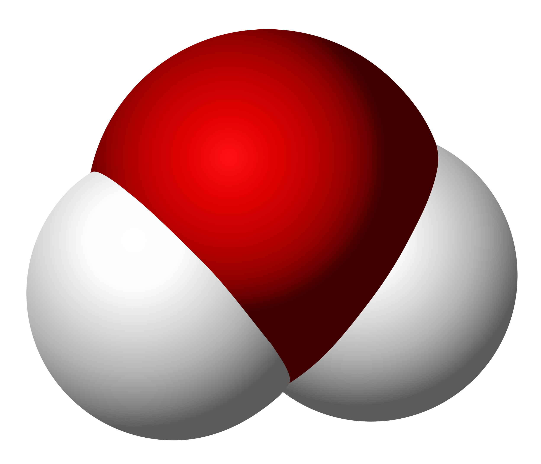
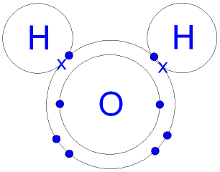
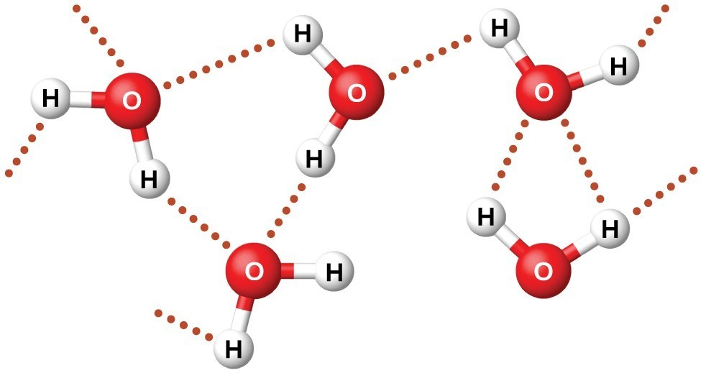
Notes:
Comparison of different graphics of water molecule– the purpose here is to show that these graphics, though they look quite different are actually the same thing (though they might be emphasizing different aspects of this molecule.

Slide 24
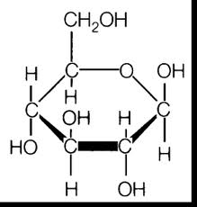
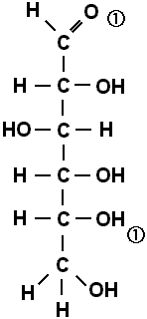
Notes:
Comparison of different graphics of sugar (glucose) molecule.

Slide 25
Texts are different: Science
Science texts characterized by…
Nominalization;
Long noun phrases;
Movement of verbs further into the sentence;
Hierarchical order to knowledge (need to know certain processes before understanding other more complicated ones)
Passive voice.
Tightly knit, highly structured, abstract, objective, multimodal

Slide 26
Texts are different: Science
Glass cracks more quickly the harder you press on it.
Cracks in glass grow faster the more pressure is put on.
Glass crack growth is faster if greater stress is applied.
The rate of glass crack growth depends on the magnitude of the applied stress.
Glass crack growth rate is associated with applied stress magnitude.
(Halliday, 2004 p. 34)

Slide 27
Texts are different: Science
Glass cracks more quickly the harder you press on it.
Cracks in glass grow faster the more pressure is put on.
Glass crack growth is faster if greater stress is applied.
The rate of glass crack growth depends on the magnitude of the applied stress.
Glass crack growth rate is associated with applied stress magnitude.
(Halliday, 2004 p. 34)
Notes:
Noun = red; verb = blue

Slide 28
Texts are different: Mathematics
Mathematics texts are characterized by…
Precision—in definitions and in the way text is read
Efficiency
Mixture of prose, formulae, graphics
Reading order changes (don’t always read left to right)
Abstraction and generalization (intense reading needed)
Concepts described in relation to each other (e.g., a triangle is described as a relationship between the three sides.)

Slide 29
Texts are different: Math
A linear equation in n unknowns x₁, x_{x}…, x_{n} is an equation of the form
a₁x₁ + a₂x₂ +…+ a_{n}x_{n} = b,
where a₁, a₂,…,a_{n}, b are given real numbers.
For example, with x and y instead of x₁ and x₂, the linear equation 2x + 3y = 6 describes the line passing through the points (3, 0) and (0, 2).
Notes:
Notice abstraction: There isn’t a real world example here. Notice the embedding of numbers and text. Concepts described in relation to each other.

Slide 30
Texts are different: Literature
Literary texts are characterized by use of…
Imagery (description, metaphor, simile);
Figuration (symbolism, irony, satire);
Rhetorical strategies and patterns (parallelism, understatement, exaggeration, repetition, allusion);
Problems of point of view (narrators);
Aesthetic choices;
Character, setting and plot development.
All in service of theme(s) author wants to develop.

Slide 31
Texts are different: Literature
The Great Gatsby: We walked through a high hallway into a bright, rosy colored space, fragilely bound into the house by French windows at either end. The windows were ajar and gleaming white against the fresh grass outside that seemed to grow a little way into the house. A breeze blew through the room, blew curtains in at one end and out the other like pale flags, twisting them up toward the frosted wedding-cake of the ceiling, and then rippled over the wine-colored rug, making a shadow on it as wind does on the sea.

Slide 32
Texts are different: Literature
The only completely stationary object in the room was an enormous couch on which two young women were buoyed up as though upon an anchored balloon. They were both in white, and their dresses were rippling and fluttering as if they had just been blown back in after a short flight around the house. I must have stood for a few moments listening to the whip and snap of the curtains and the groan of a picture on the wall. Then there was a boom as Tom Buchanan shut the rear windows and the caught wind died out about the room, and the curtains and the rugs and the two young women ballooned slowly to the floor.

Slide 33
Texts are different: Literature
The Great Gatsby: We walked through a high hallway into a bright, rosy colored space, fragilely bound into the house by French windows at either end. The windows were ajar and gleaming white against the fresh grass outside that seemed to grow a little way into the house. A breeze blew through the room, blew curtains in at one end and out the other like pale flags, twisting them up toward the frosted wedding-cake of the ceiling, and then rippled over the wine-colored rug, making a shadow on it as wind does on the sea.
Notes:
Description = gray, characters = blue; imagery = orange; figuration (symbolism) = red; setting = purple Who is the narrator?

Slide 34
Texts are different: Literature
The only completely stationary object in the room was an enormous couch on which two young women were buoyed up as though upon an anchored balloon. They were both in white, and their dresses were rippling and fluttering as if they had just been blown back in after a short flight around the house. I must have stood for a few moments listening to the whip and snap of the curtains and the groan of a picture on the wall. Then there was a boom as Tom Buchanan shut the rear windows and the caught wind died out about the room, and the curtains and the rugs and the two young women ballooned slowly to the floor.
Notes:
Characters = blue; symbolism = red; imagery = orange; plot development = green. Who is the narrator? What do you know about the characters? What do these things say about a developing plot?

Slide 35
Multiple Texts

Slide 36
Multiple texts
Multiple texts are necessary when…
Evidence is unclear
People disagree about the interpretation of evidence
Evidence is incomplete
Interpretation of evidence is biased
Evidence lacks coherence
These conditions tend to exist in history, political science/civics, economics, geography, etc.

Slide 37
Role of multiple texts
Discipline | Multiple Texts?
History | Essential
Science | Unnecessary if textbook is good
Math | Unnecessary if textbook is good
Literature | Irrelevant
Social Studies | Essential for many topics

Slide 38
Civics
When citizens exercise the right to vote, they need to be informed, but information is often not clear and different sources disagree.
e.g. People disagree about whether or not
the party system is outdated, or the
interpretation of free speech.

Slide 39
Economics
The answers to a number of questions are contested
Do you favor supply side or demand side economics?
What will happen if tariffs go up?
What will be the effect on our economy if the economy of a major country collapses?
Is it better to invest individual stocks or index funds?

Slide 40
Geography
The answers to many questions are contested
How does an area’s topography effect its economy?
What causes the migration of peoples?

Slide 41
Vocabulary

Slide 42
Role of Vocabulary
Content Area Reading
Students need to learn terminology in all fields.
The same study techniques would accomplish this no matter what the words.
Graphic organizers, semantic maps, word sorts, rate knowledge of words, analyze semantic features of words, categorizing/mapping words, synonym webs, etc.
Disciplinary Literacy
Terminology is specific to the fields of study.
Different types of words require different ways to identify and learn them.
The study techniques depend on the type of words that are learned.

Slide 43
Role of Vocabulary
What to teach?
The nature of vocabulary in a discipline
How to interpret morphology
How to use of context
Use of appropriate reference guides

Slide 44
Words are different
Discipline | Vocabulary features
History | Metaphorical terms, terms with political points of view E.g., War of Northern Aggression vs. War Between the States vs. Civil War; The Gilded Age; Revolutionary Movements vs. Soviet Expansionism
Science | Greek and Latin Roots (precise, dense, stable meanings that are recoverable, show relationships). E.g., deoxyribonucleic; haploid; diploid
Math | Words with precise definitions that are different than general meanings e.g., factor, prime
Literature | Words describing emotions, states of mind, the senses e.g. paroxysm, “the insane joy of the hunt, when as I climb the rock, my face contorted, gasping, shouting voluptuously senseless words
Notes:
Haploid: cell with a single set of unpaired chromosomes (half the normal number, not from both parents)
Diploid: cell with two complete sets of chromosomes, one from each parent
Meiosis: cell division in which the new cells are not identical to the parent cells osis (less process or action)
Mitosis: cell division in which the new cells are identical to the parent cells (thread process)
Black Friday
Gilded Age
Reverse discrimination vs. affirmative action
Negro vs. Black vs. African-American
U.S. Civil War or War Between the States or War of Northern Aggression
Vietnam War or the Resistance War Against America

