Slide 1
Science Graphics
Timothy Shanahan
University of Illinois at Chicago
www.shanahanonliteracy.com

Slide 2
Science Graphics
There are a large number of tables, charts, graphics, 3-dimensional representations, scientific drawings, flowcharts, photographs, etc. used in scientific communication (and many ways to categorize these)
No attempt to show all possible graphics, just some major ones
Focus is on teaching students to identify their purposes and to interpret them appropriately (in relation to the rest of the scientific information)

Slide 3
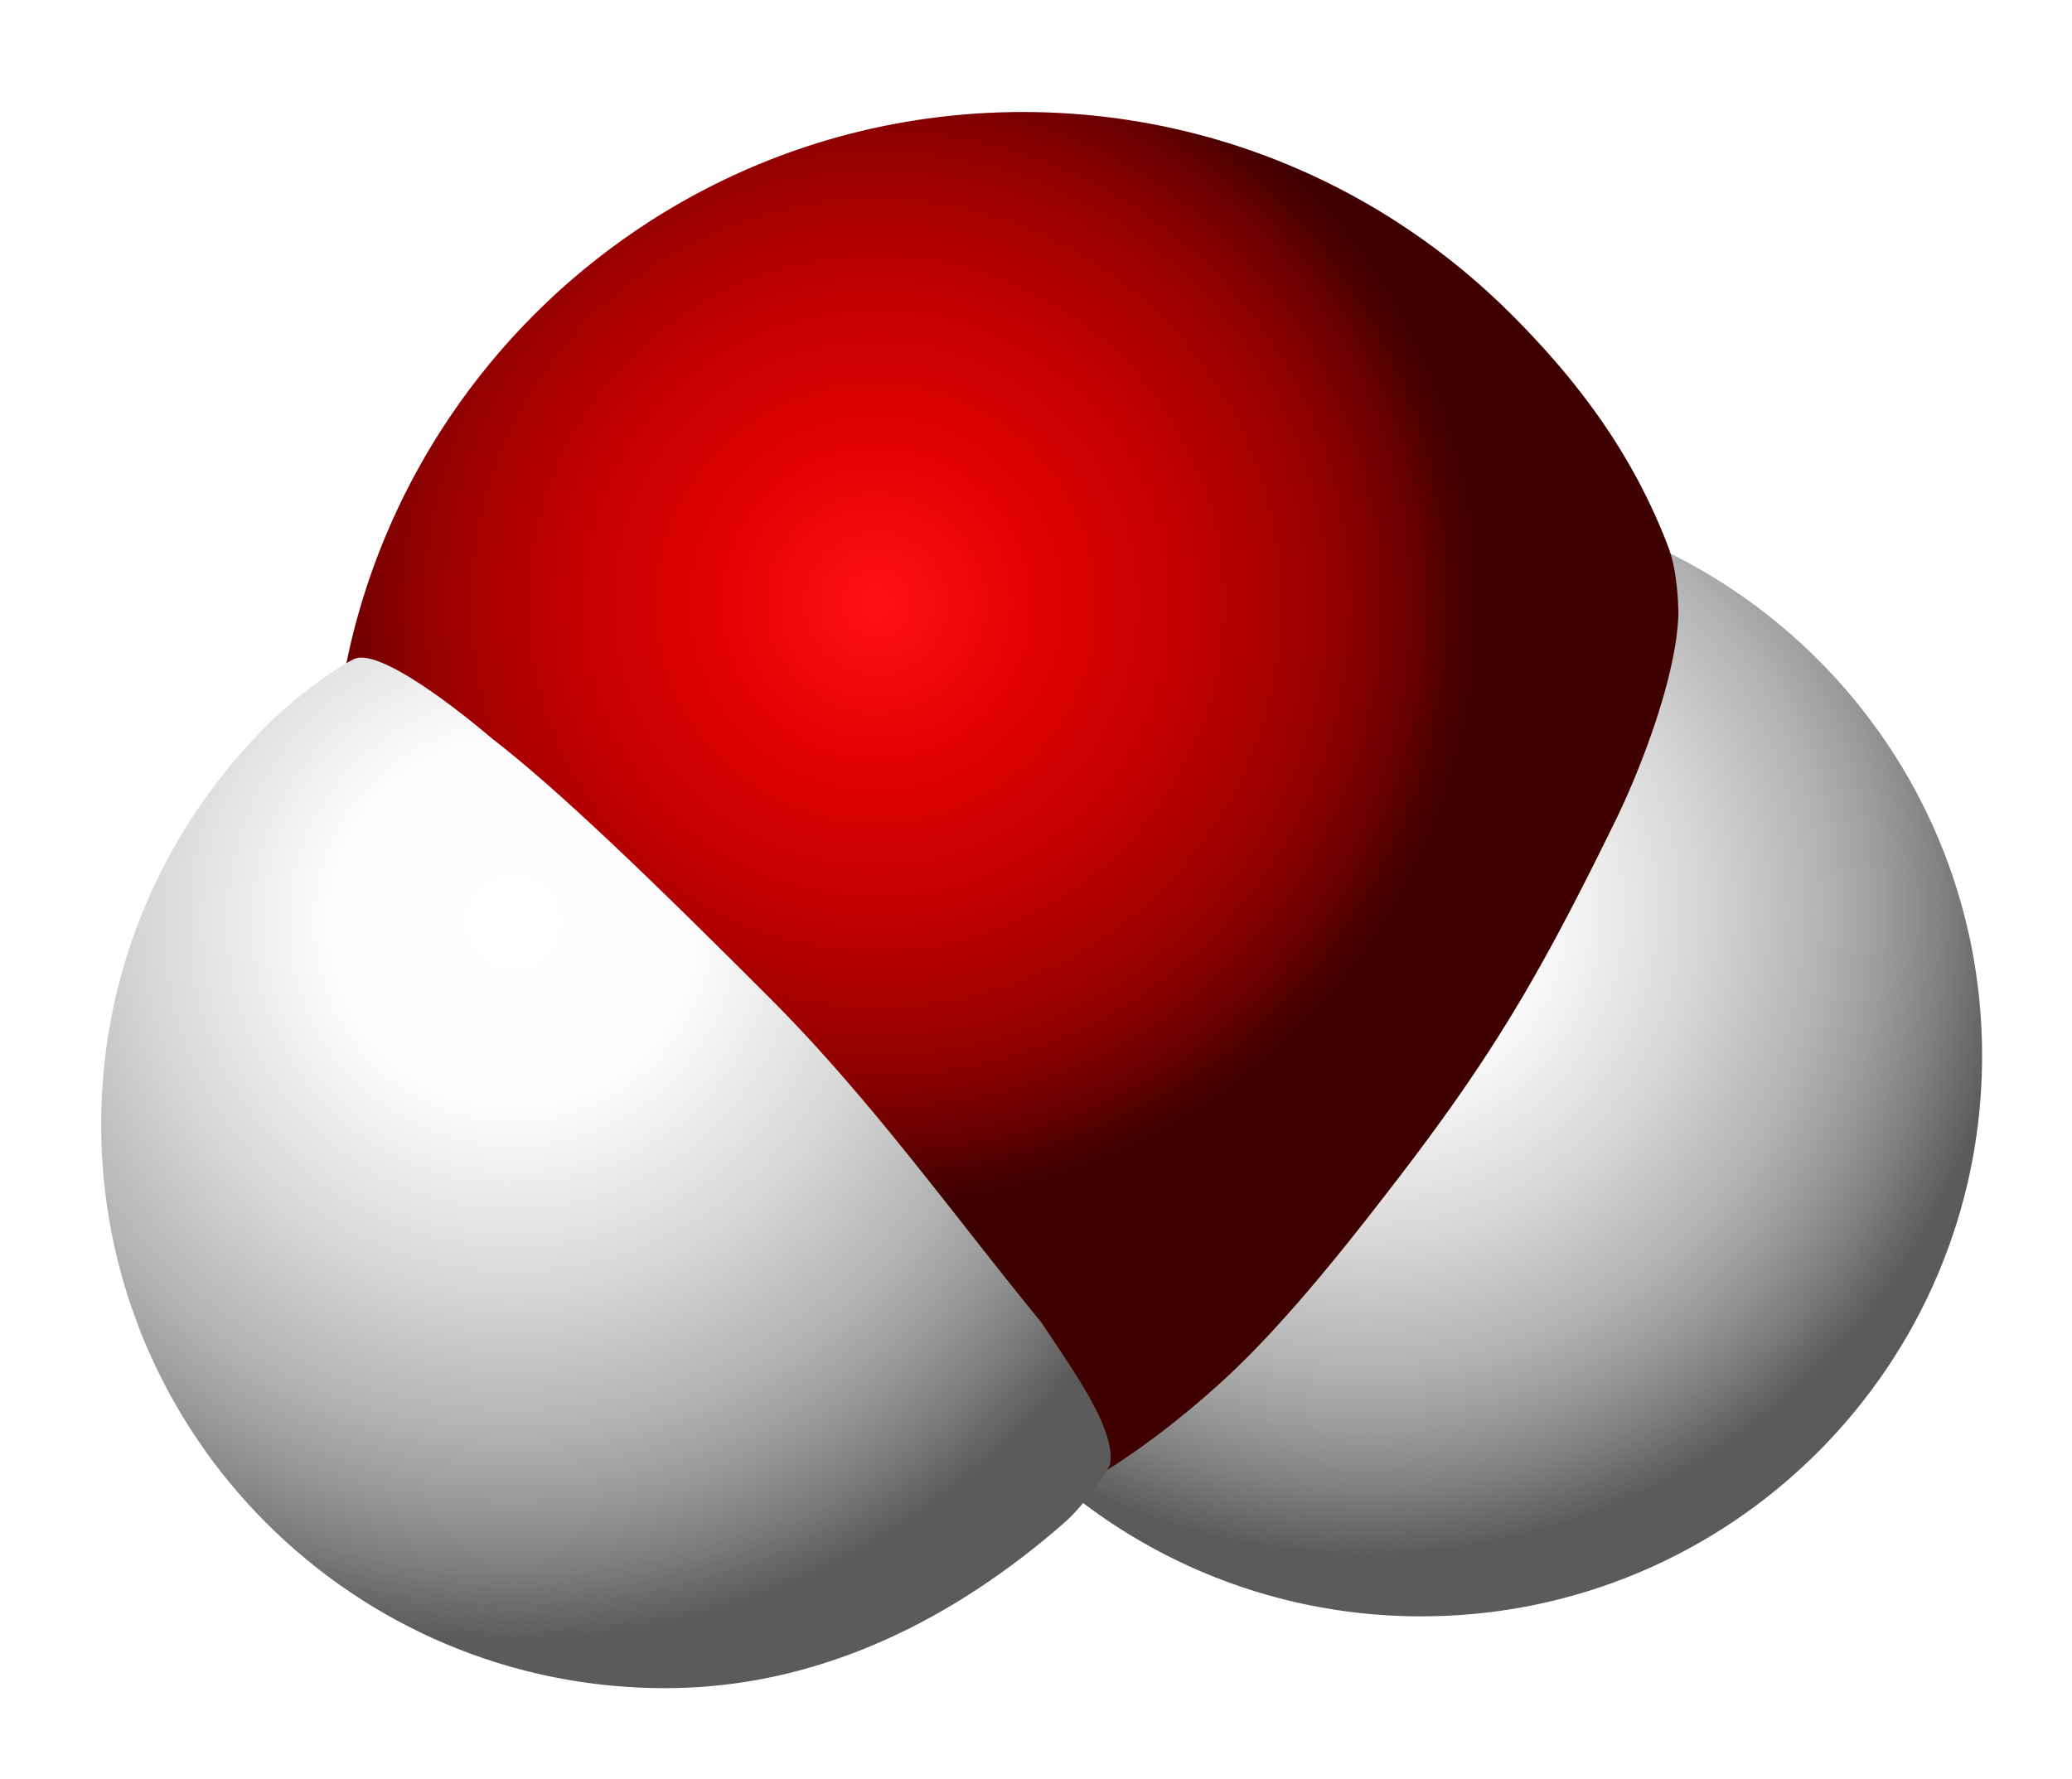
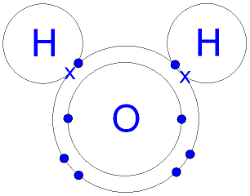
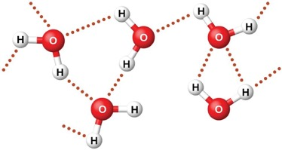
What do these have in common?
Notes:
Comparison of different graphics of water molecule– the purpose here is to show that these graphics, though they look quite different are actually the same thing (though they might be emphasizing different aspects of this molecule.

Slide 4
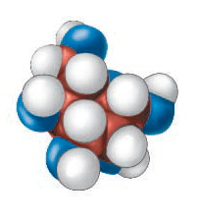
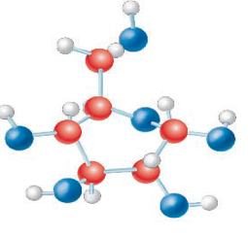
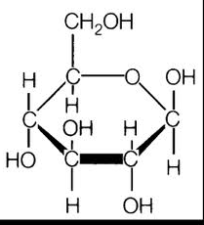
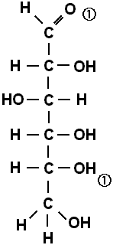
What do these have in common?
Notes:
Comparison of different graphics of sugar (glucose) molecule.

Slide 5
Graphic Purposes
Spatial graphics: represent spatial placement of objects or the physical relationships among objects or parts (e.g., photos, scientific drawings)
An understanding of spatial graphics is demonstrated by being able to describe (or remember) the relative placements of the items in the graphics
Not enough to remember the actual items represented—understanding their relationships is key

Slide 6
Graphic Purposes (cont)
Sequential graphics: represent the steps in a process or cycle (e.g., flow charts)
An understanding of sequential graphics requires that readers be able to describe the steps in the process in an appropriate sequence (and key features of the process such as asymmetricity, circularity, etc.)

Slide 7
Graphic Purposes (cont)
Comparative graphics: reveal similarities and differences in phenomena or processes (includes scientific drawings, tables, bar graphs, etc.)
Understanding comparative graphics requires that readers recognize what is being compared and to be able to draw appropriate generalizations from the comparisons

Slide 8
Graphic Purposes (cont).
Classification/Hierarchical graphics: reveal taxonomic or rank relationships or arrangements among phenomena, objects, processes, etc. (includes tree diagrams, category graphs, etc.)
Understanding classification/ hierarchical graphics requires recognizing what is being compared and whether the nature of the relations being pictured (e.g., superior to inferior, general to specific)

Slide 9
Graphic Purposes (cont)
Causal graphics: reveal what conditions or actions lead to particular outcomes (can take many forms, but be especially careful of graphics that illustrate relationships between two variables-–those are not necessarily causal, but may be correlational)
Understanding requires being able to describe the antecedent the consequent and how the the former impacts the latter

Slide 10
Graphic Purposes (cont)
Spatial graphics
Sequential graphics
Comparative
Classification/Hierarchical
Causal

Slide 11
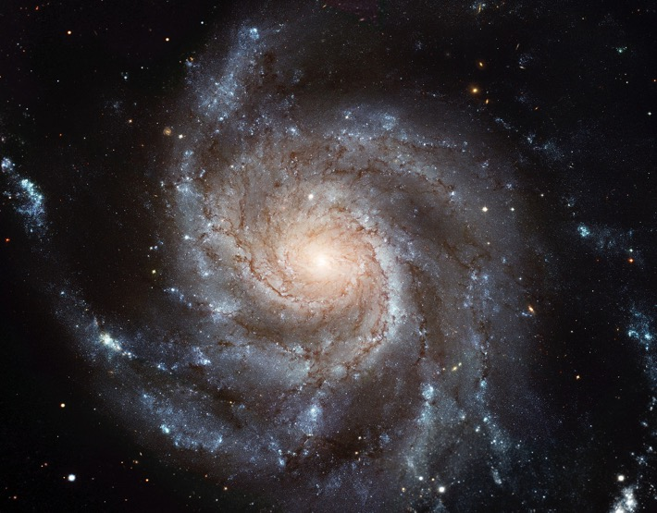
Spatial
Sequential
Comparative
Classif/Hierarch
Causal
Notes:
Most spiral galaxies consist of a flat, rotating disk containing stars, gas and dust, and a central concentration of stars known as the bulge. ... Together with irregular galaxies, spiral galaxies make up approximately 60% of galaxies in today'suniverse.
NOUN
SPATIAL

Slide 12
Spatial
Sequential
Comparative
Classif/Hierarch
Causal
Notes:
Process/verb: Water cycle
The water cycle describes how water evaporates from the surface of the earth, rises into the atmosphere, cools and condenses into rain or snow in clouds, and falls again to the surface as precipitation.
Transpiration: plants give off water through their pores
Infiltration: water seeping through the soil to the water table

Slide 13
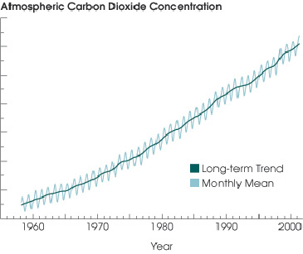
Spatial
Sequential
Comparative
Classif/Hierarch
Causal
Notes:
This is a comparison… it allows one to compare how much atmospheric carbon dioxide there was each decade since 1960

Slide 14
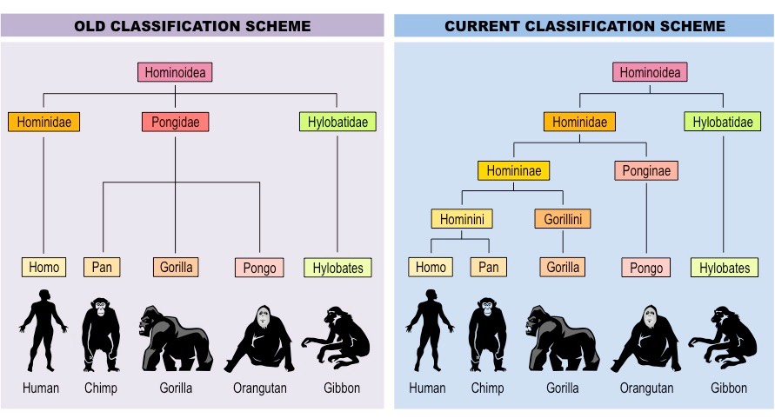
Spatial
Sequential
Comparative
Classif/Hierarch
Causal
Notes:
Classification and Comparison
Classification of hom-in-oid-ea;
We used to think man was a distinct or unique member of the hominoidea family… newer classification schemes recognize more fine grained distinctions and closer connections with some other members of the family.

Slide 15
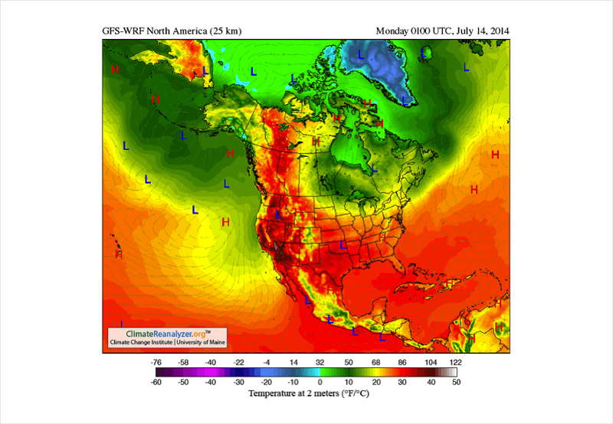
Spatial
Sequential
Comparative
Classif/Hierarch
Causal
Notes:
Spatial / Comaprative
Shows temperature locations

Slide 16
Spatial
Sequential
Comparative
Classif/Hierarch
Causal
Notes:
Classification (taxonomy) in hierarchical tree form (general to specific)

Slide 17
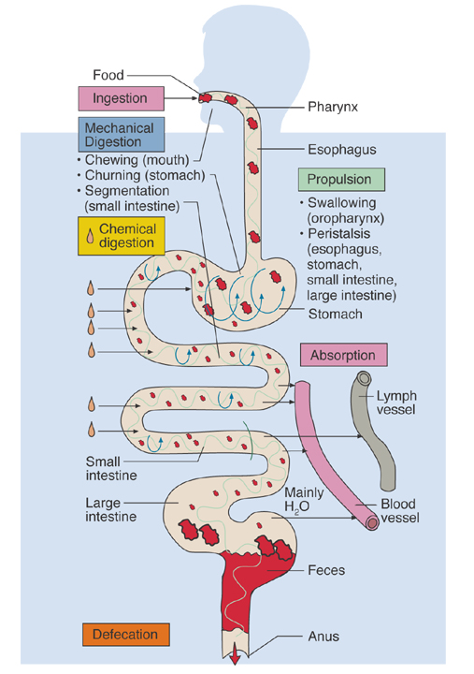
Spatial
Sequential
Comparative
Classif/Hierarch
Causal
Notes:
Sequential—illustrates the digestion process
Spatial—shows the placement of the digestion system

Slide 18
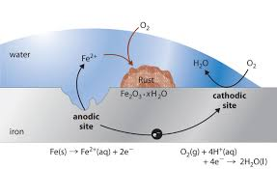
Spatial
Sequential
Comparative
Classif/Hierarch
Causal
Notes:
Shows iron rusting
Causal– shows how Oxygen merges into water and how the oxygen from water bonds with iron to create rust
Sequential—it is a process

Slide 19
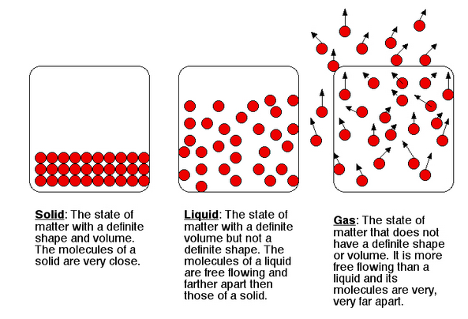
Spatial
Sequential
Comparative
Classif/Hierarch
Causal
Notes:
Comparison of different forms of H2O

Slide 20
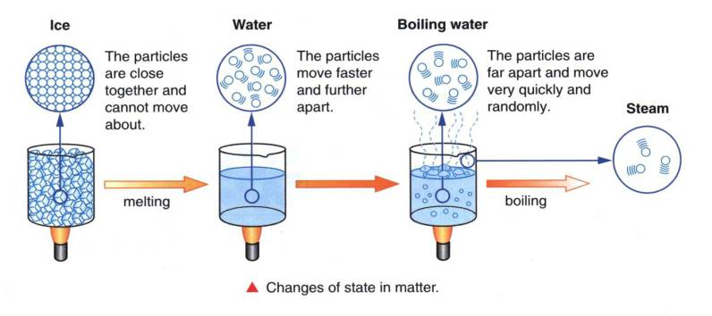
Spatial
Sequential
Comparative
Classif/Hierarch
Causal
Notes:
Causation—the areas show how the state of matter is changed by heat
Comparison

Slide 21
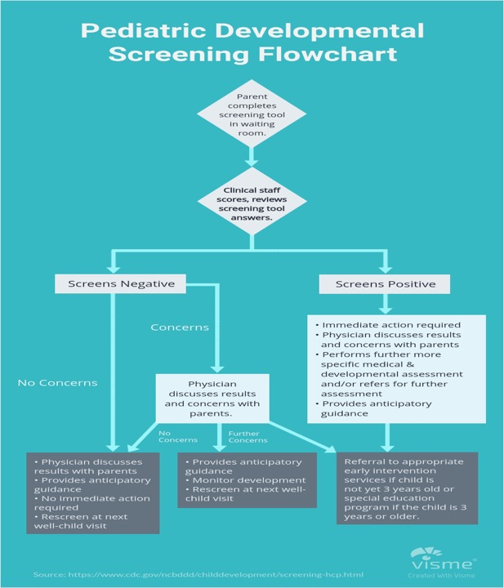
Spatial
Sequential
Comparative
Classif/Hierarch
Causal
Notes:
Sequence process flowchart

Slide 22
Spatial
Sequential
Comparative
Classif/Hierarch
Causal
Notes:
Causal relationships

Slide 23
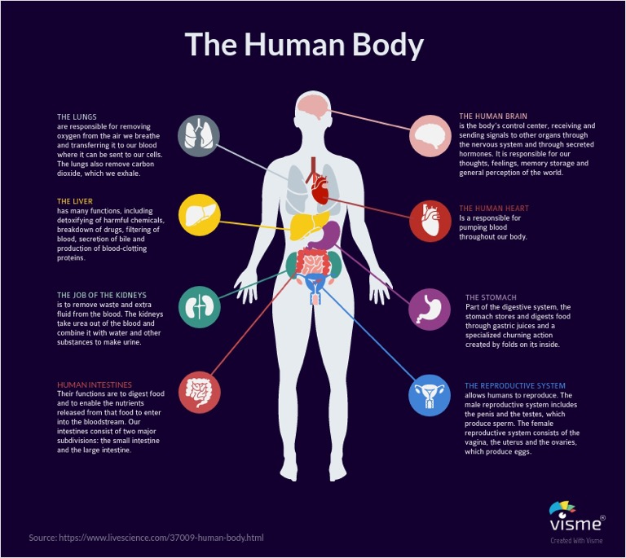
Spatial
Sequential
Comparative
Classif/Hierarch
Causal
Notes:
Spatial, classification

Slide 24
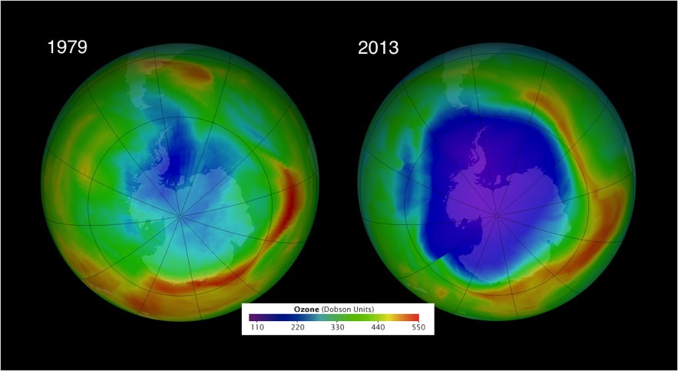
Spatial
Sequential
Comparative
Classif/Hierarch
Causal
Notes:
Comparison of ozone layer at two different times

Slide 25
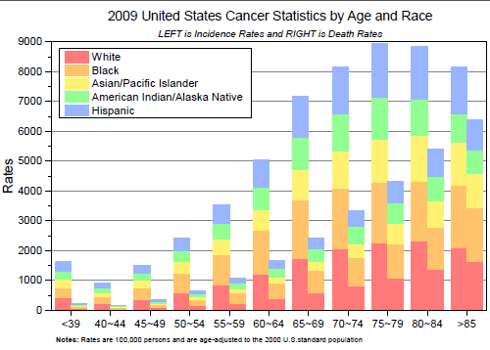
Spatial
Sequential
Comparative
Classif/Hierarch
Causal
Notes:
Comparison

Slide 26
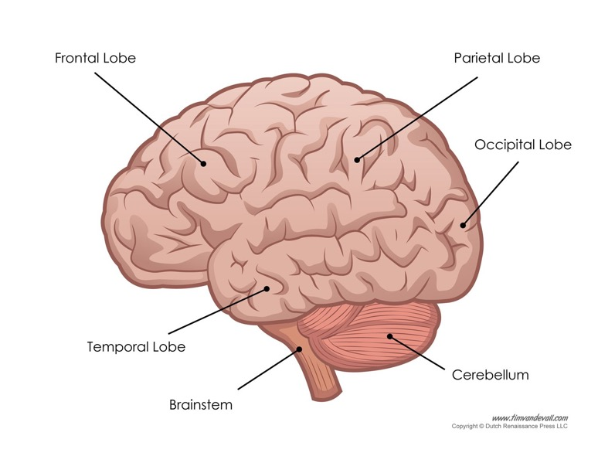
Spatial
Sequential
Comparative
Classif/Hierarch
Causal
Notes:
Spatial structure of human brain

Slide 27
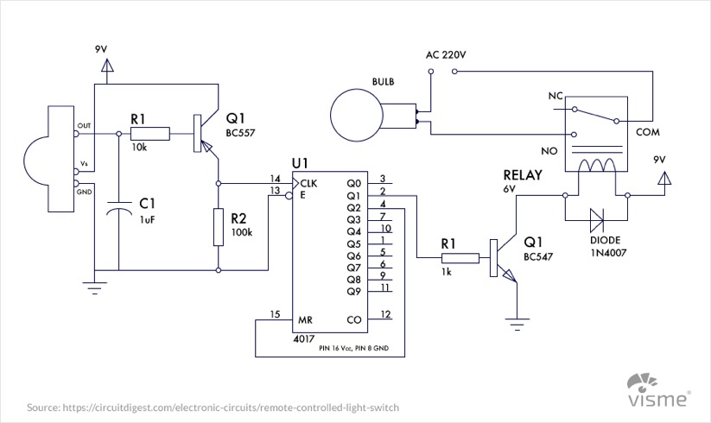
Spatial
Sequential
Comparative
Classif/Hierarch
Causal
Notes:
Spatial – engineering blueprint… showing circuits

Slide 28
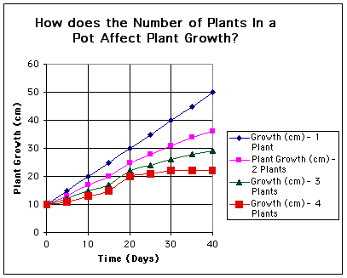
Spatial
Sequential
Comparative
Classif/Hierarch
Causal
Notes:
Causal—relationship of growth rates in an experiment (crowding impact on growth)
Comparison

Slide 29
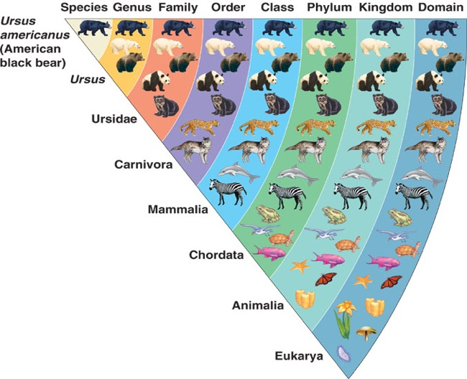
Spatial
Sequential
Comparative
Classif/Hierarch
Causal
Notes:
Classification – Classifying where the American black bear fits in biological classification system (taxonomy ranks)
Comparative

